Slide 1
Shopping Cart
By: Dhruti Pandya, Amish Raj & Rahul Sangewar

Slide 2
Vision:
Our e-commerce website strives to create a seamless and enjoyable shopping experience for customers. We aim to design a website that is user-friendly, easy to navigate, and visually appealing.
Our vision is to create a user-friendly platform which is scalable and easily adaptable. A platform which is straightforward to use and does not require a user to take so many steps in order to buy their basic items. Any one can purchase the product without having to create an account on the website by opting as a temporary users whose data won’t be recorded and ensuring security measures to protect our customers' information.

Slide 3
Actors
User - Users can be subcategorized into two sub groups namely Buyer and Seller.
Buyer - Buyer’s role is to create its account, add items into the cart, provide the feedback if any, etc.
Seller - Manages the inventory of the items that are to sell, process the refunds, runs the promo codes.
Paypal - Processes the payments.

Slide 4
Use case
View Inventory - View the inventory of the product(s)
Add to Cart - Add selected item(s) to cart
Checkout - Checkout the cart items to proceed to pay
Leave Rating - Old customers can leave reviews and the seller can reply to the product reviews
Temp Account - The user can interact with their temporary user account which stores their information
User Info - Interact with User Info to store addresses, payment methods, and personal details of the user
Payment Info - Payment vendors (like paypal) and customers interact with the payment information of the user to fulfill the payment

Slide 5
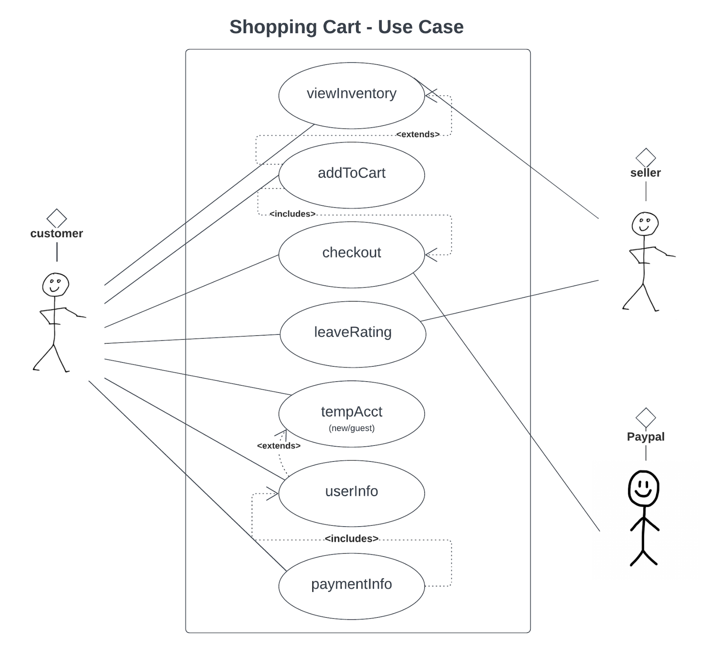

Slide 6
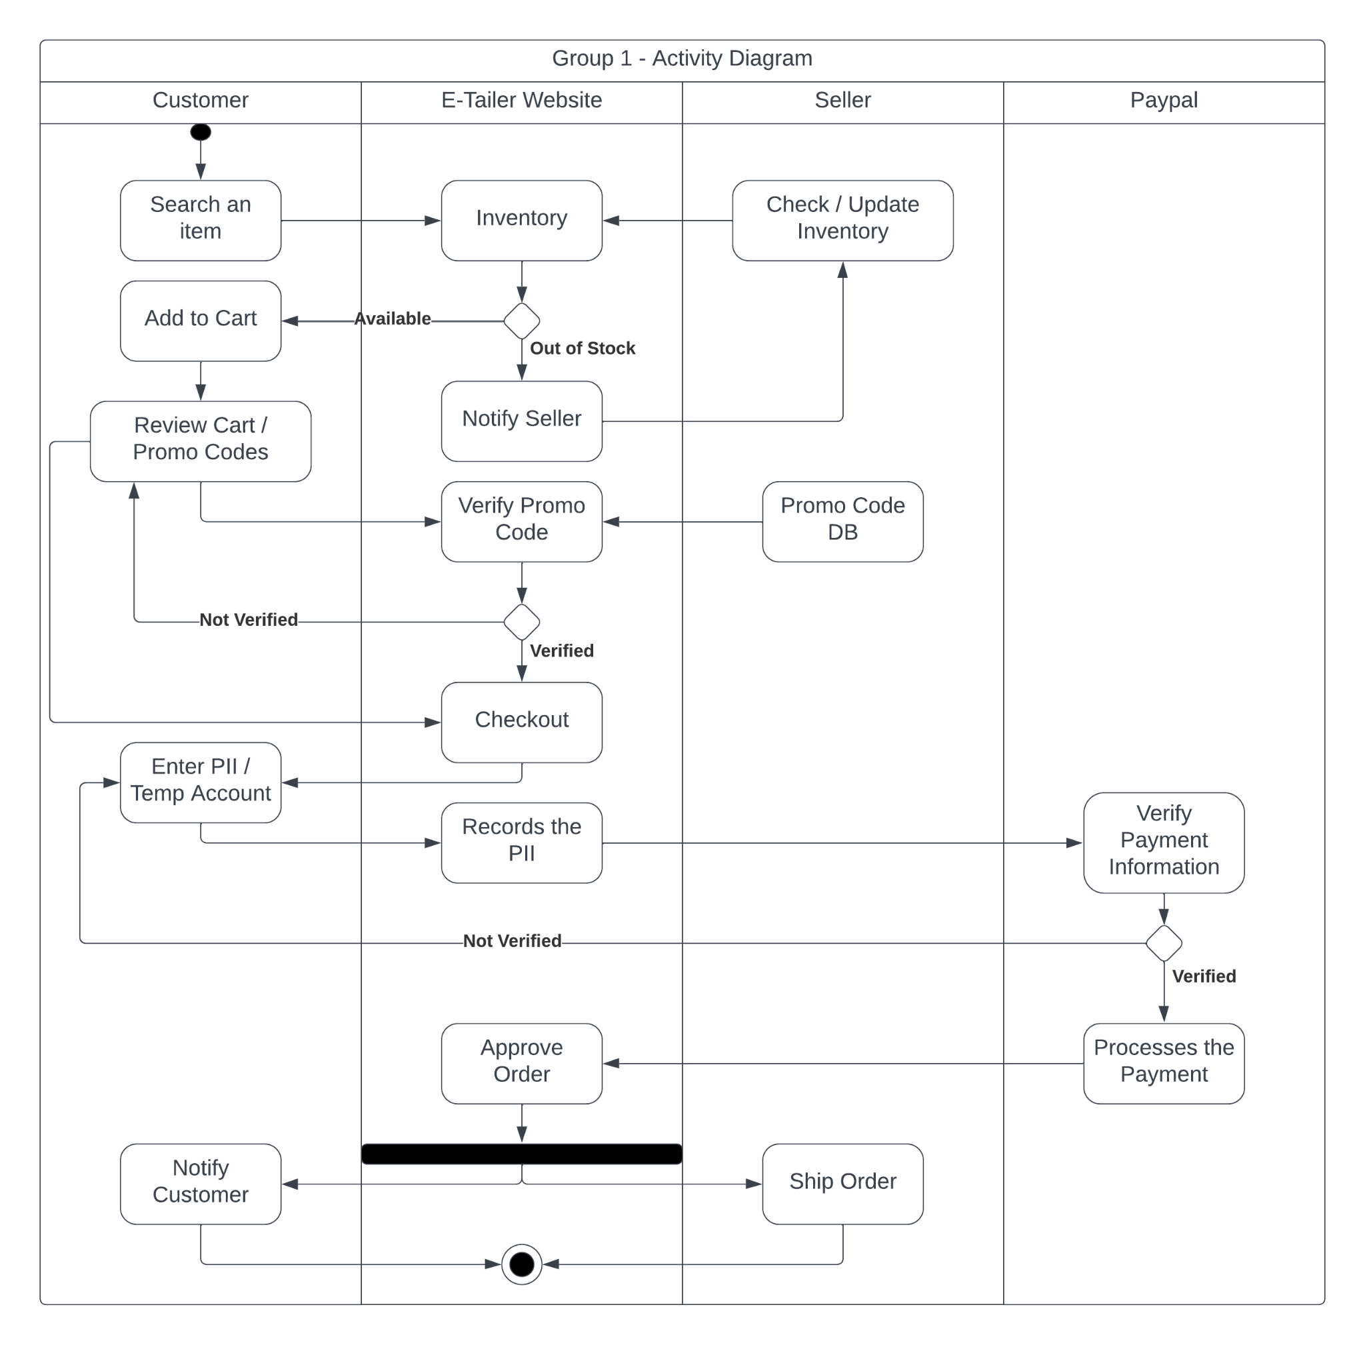
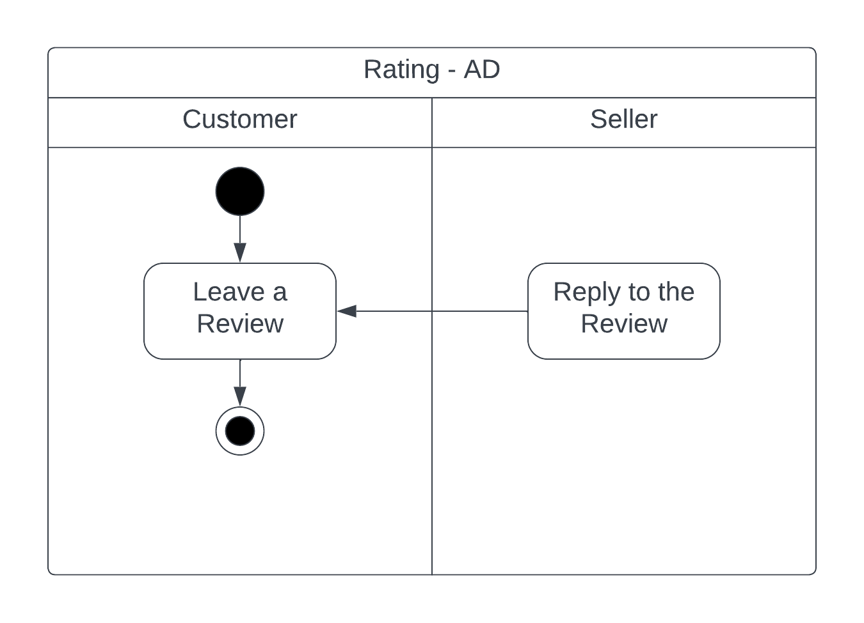
Activity Diagram

Slide 7
Domain Model Noun Phrases
{Class(C), Actor(R), Attributes (A)}
User (C, R) can enter their Name (A), Phone Number (A), Email Address (A), Mailing Address (A), Credentials (A), Billing Address (A) to the Payment Info (C)
Buyer(C, R) can add Product(s) (C) to the Cart (C)
Seller (C, R) can manage Product(s) (C) to the Cart (C)
A User (C, R) can post Ratings (C) with a Star number (A) and a Review (A)
A User (C, R) has Temporary Account(s) (C)
A Buyer (C, R) can add many products (C) to a cart (C)
A Seller (C, R) can have many products (C) in an Inventory (C)
Paypal/Vendor(R,C) processes the Payment Info (C)
A Seller (C, R) sells a Product (C) with a Product Name(A) and a Price(A)
A Buyer (C, R) buys a quantity (A) of a Product(s)

Slide 8
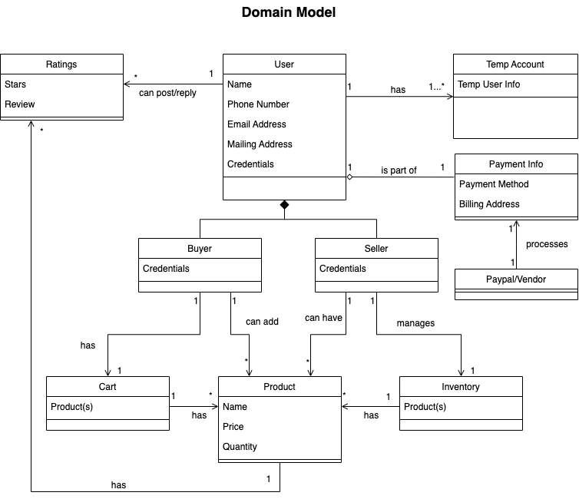

Slide 9
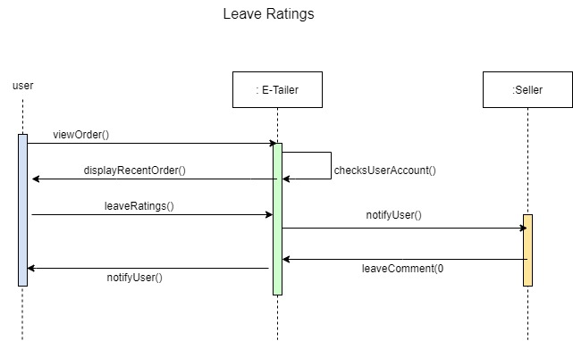
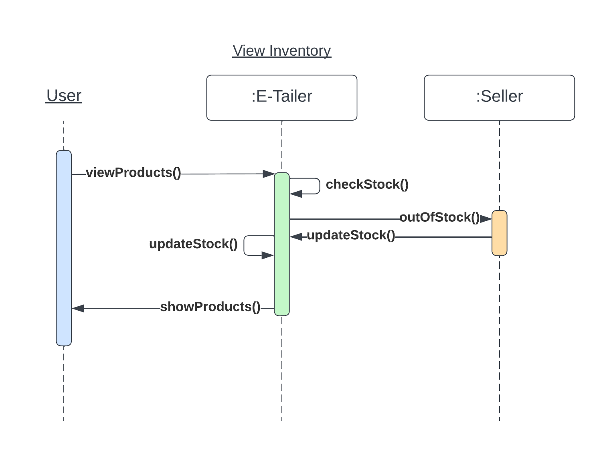
Sequence Diagram(s)

Slide 10
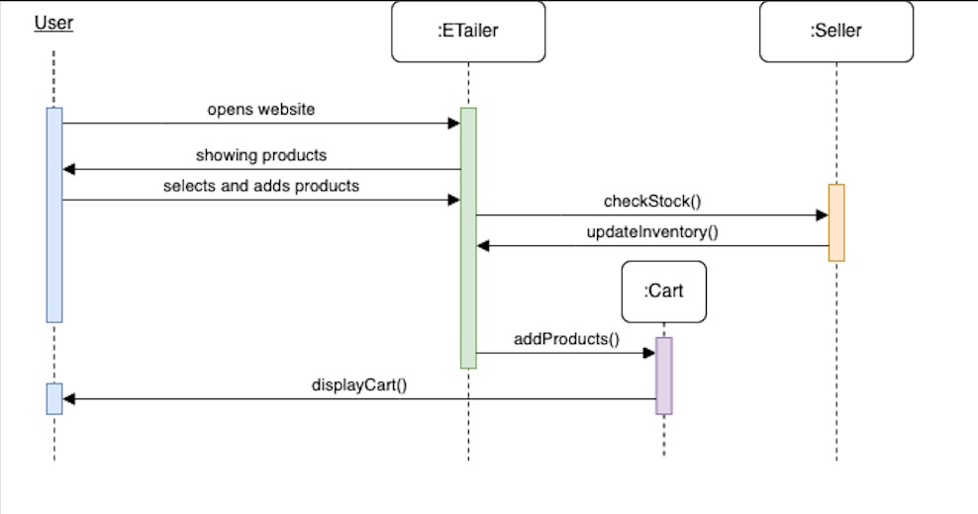
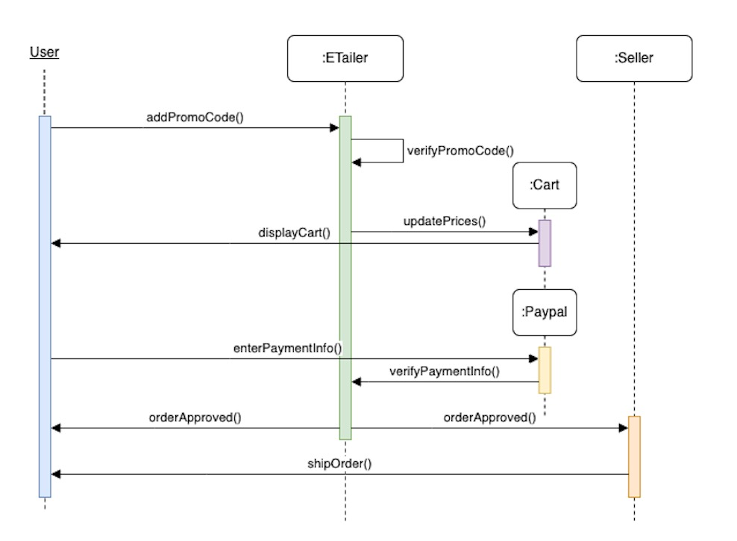
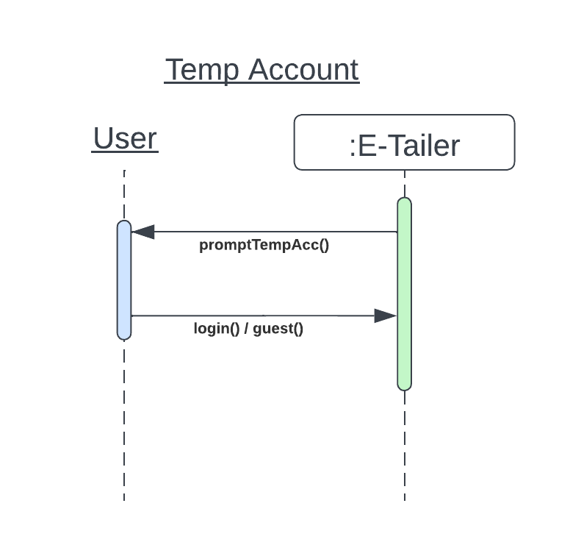
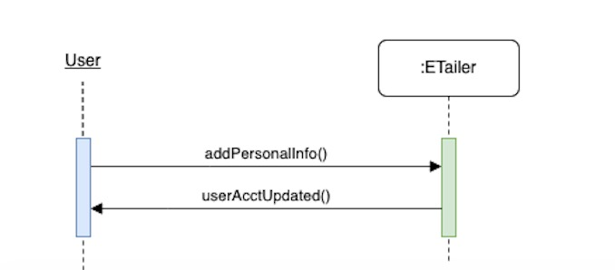
Continued..
Add to cart
Checkout
User Info

Slide 11
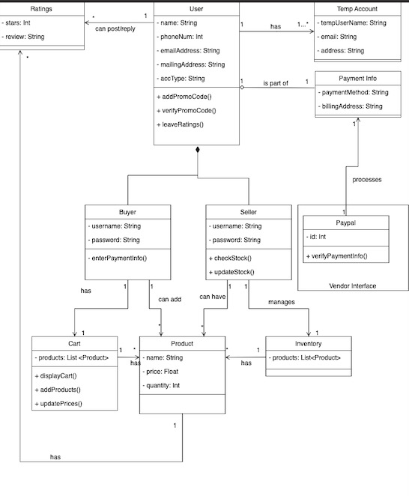
Updated Class Diagram

